Slide 1
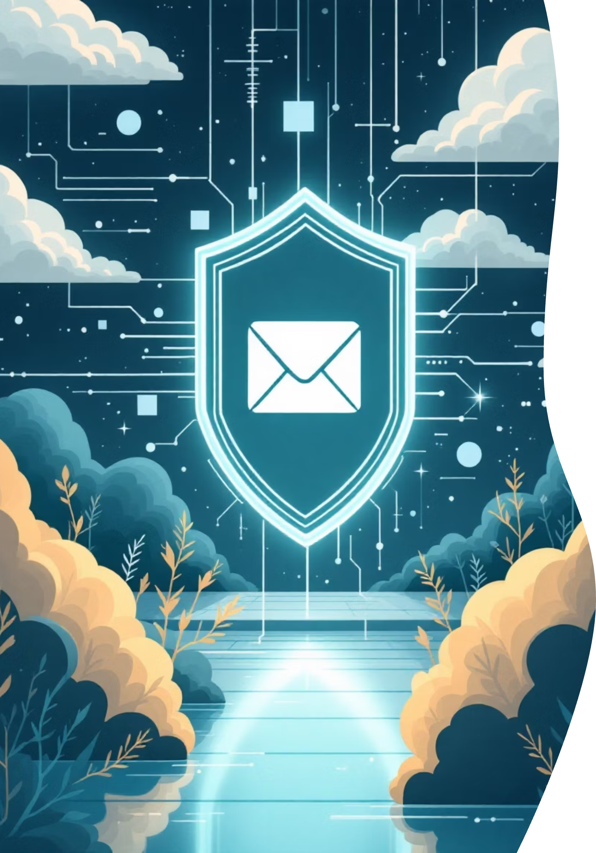



PHISHING GUARD AI DETECTION
AI SHIELD
CIEL KINGSTON
VIBEAITHON 2025
"Empowering Users Against Intelligent Email Threats."
AJAY S
ZUBAIR ZAMAN V G
Lead & Frontend Developer
Backend Developer
MUHAMMED ARSHATH R
API, ML & Integration Manager

Slide 2
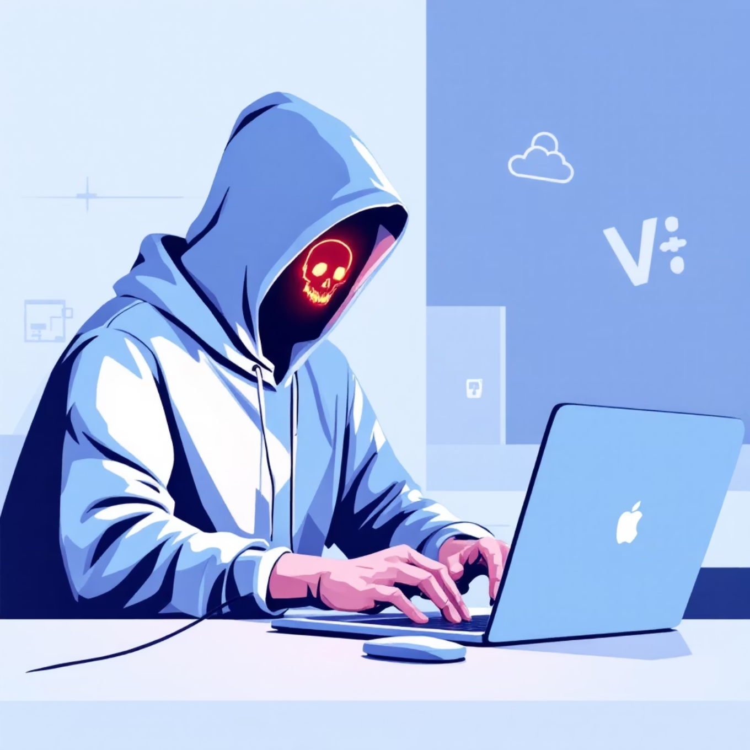
THE CHALLENGE
The Rise of
AI-Generated Phishing
Phishing remains the most common cybersecurity threat. AI-generated scams are increasingly sophisticated, making them harder to detect by traditional filters.
Our objective is to develop an AI-driven detection system capable of analyzing and classifying phishing emails in real time with over 95% accuracy.
Reduce Incidents
Improve Trust
Adaptive Model
Proactive detection to significantly lower the number of successful phishing attacks.
Increase user confidence in digital communications and email security.
Deliver a system that continuously evolves with new and emerging threat patterns.

Slide 3
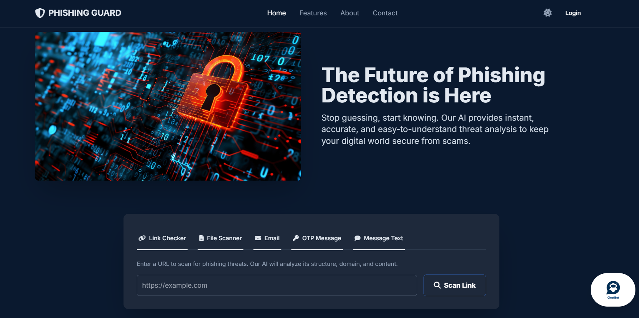
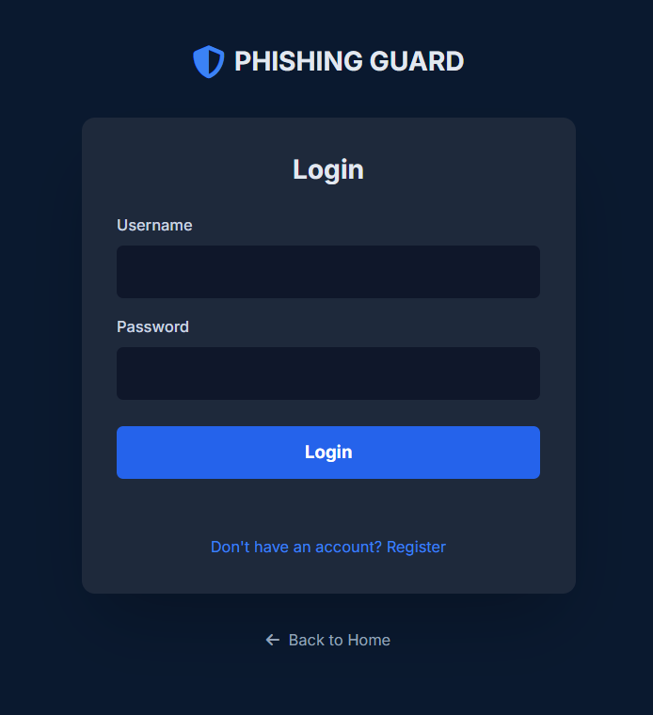
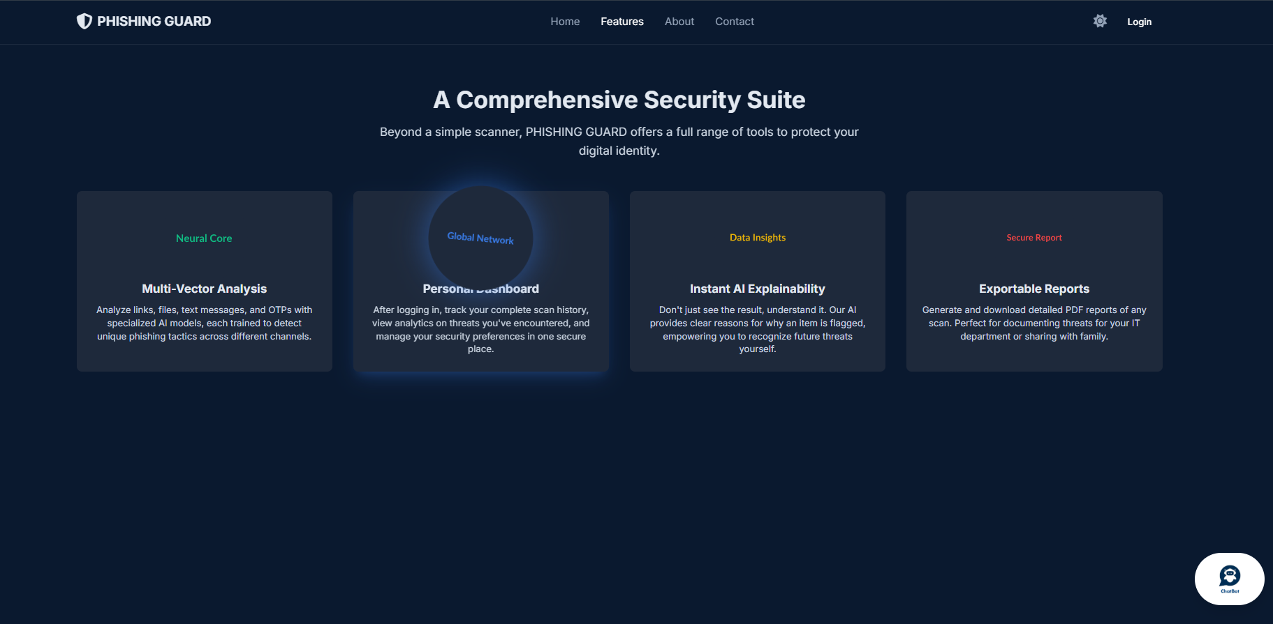

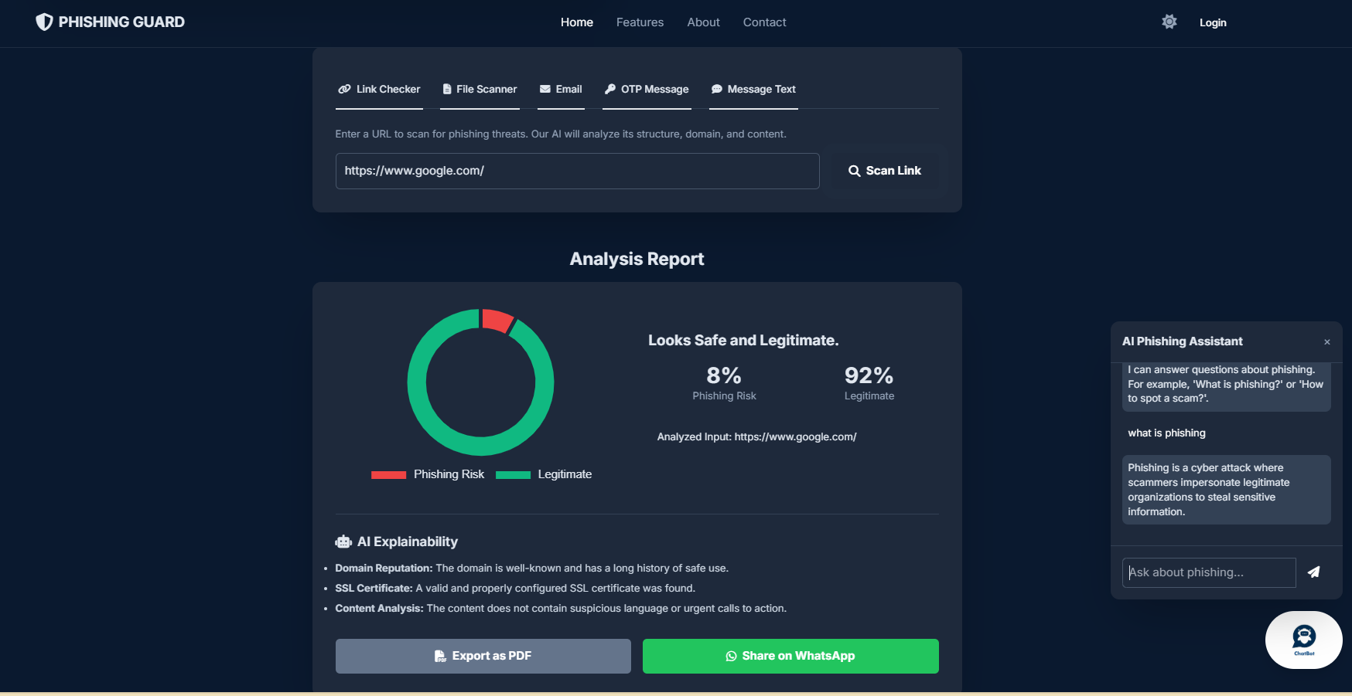


THE SOLUTION
Phishing Guard AI: Prototype Overview
Phishing Guard AI is an intelligent, fully functional web-based platform that scans incoming emails, identifies suspicious patterns, and alerts users instantly in a live testing environment.
Frontend
HTML, CSS, JS
Backend
Python (Flask)
Database
MySQL

Slide 4




USER EXPERIENCE
The Proactive User Journey
Login & Scan
AI Analysis
User logs into the dashboard; system scans recent emails.
Model analyzes text, sender details, and embedded links.
Classification
Alert & Action
Email is classified as Safe, Suspicious, or Phishing.
User receives visual alerts and recommended protective actions.
Core Impact
Key Innovation
Prevents credential theft and critical data leaks.
Context-aware detection using Natural Language Understanding (NLU).
Saves organizational and personal losses from scams.
Builds cyber resilience through AI-driven awareness.
Continuous self-learning via user feedback loops.

Slide 5

VISUALIZING SUCCESS
Dashboard & Confidence
The interface provides clear, actionable insights, turning complex AI analysis into simple user decisions.
The system's visual elements are designed for immediate clarity, ensuring users can quickly identify and act on threats without technical expertise.

Slide 6
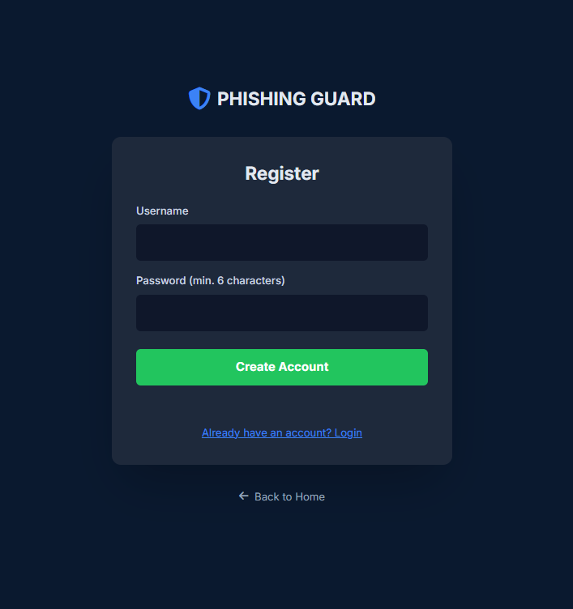
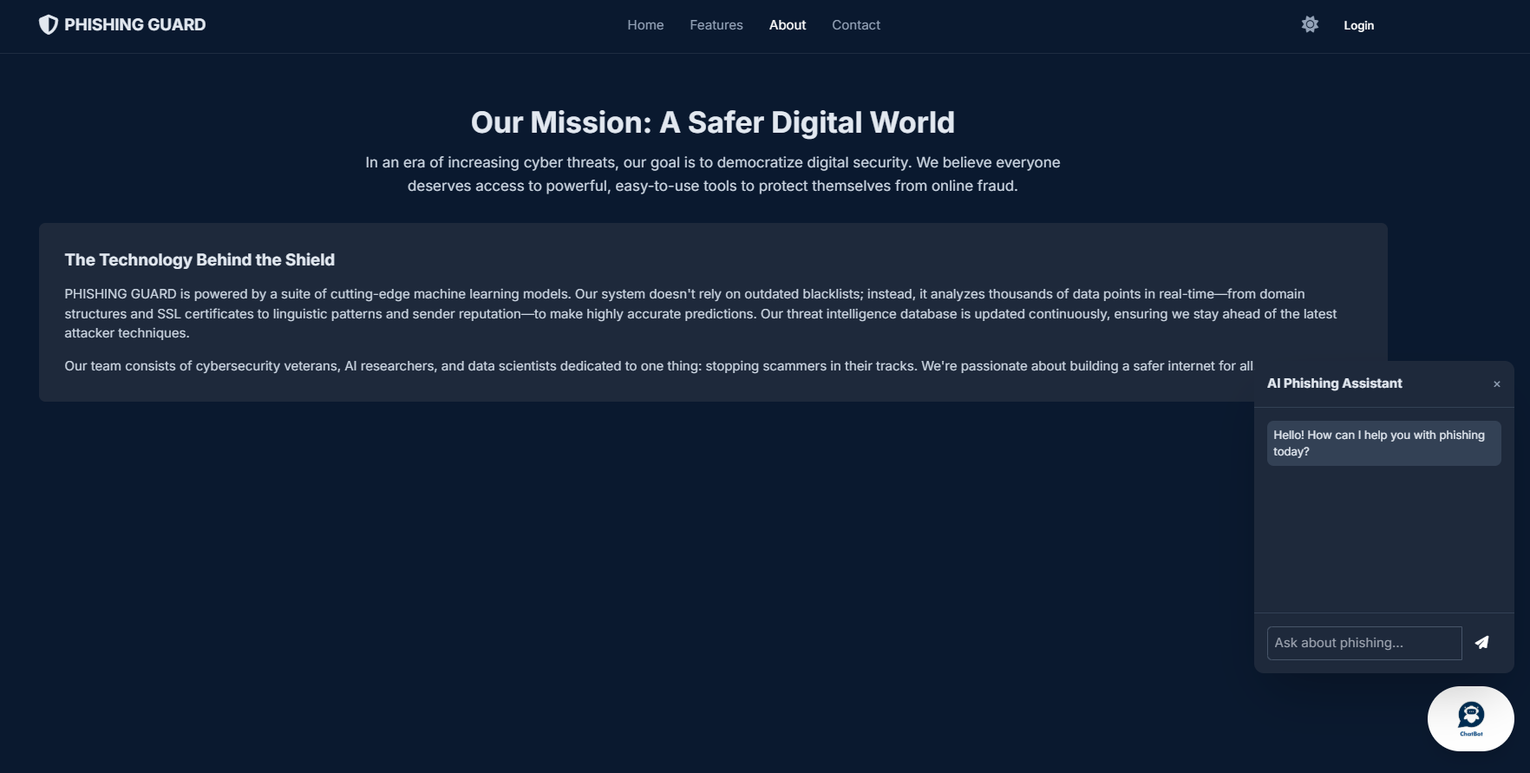
THANK YOU

